Slide 1
POWER BILLING SYSTEMS
WEB BASED APPLICATION

Slide 2
INTRODUCTION
The Energy Billing System is an Executive Information System that could be used foe entering,calculating and monitoring the billing details of the Electricity consumers
It provides Environment to maintains the consumer details starting from getting new connection ,receiving bill,payments etc., and performance information to the management
It would be an Intranet and Internet based software solution
The following are the activities going at all the ERO
  Registration of new service connections
  Uploading and downloading of the metering data, which was done by Spot Billing Machine
  Offline connections ,RJ and changes information is entering
  Taking daily collections reports
  Bill processing, D-List processing and Ledger Processing
  Generating Monthly Reports
  Receive collection data from external agencies

Slide 3
ORGANIZATOIN PROFILE
APCPDCL is a licensee under section 15 of the AP Electricity Reform Act,1998 entrusted with the responsibility of the distribution of electricity to 4.5 million consumers spread over seven districts including the twin cities of secundrabad and Hyderabad
The central power Distribution company with an Authorized capital of Rs.655 crores is engaged in the business of supply and distribution of electricity,purchasing,selling,importing,exporting,wheeling and trading of electrical and other related activities
The APCPDCL is committed to quality supply and correct meter reading . Under this direction,it has introduced the Spot Billing System.
APCPDCL has also plan to launch similar consumer care centers in 24 more areas with in the twin cities shortly, and in all districts with in its purview
The main aim of the scheme is to provide better,quicker and more responsive and responsible services to its consumers
The APCPDCL now also provides exclusive help lines to consumers of the twin cities and RANGA REDDY District to redress their mpower problems

Slide 4
PROJECT OVERVIEW
Energy Billing System:
Common Billing system is a system to maintain billing details in ERO. It captures the data related to billing and doing manipulations like calculate bill and payments receipts
In this we can divide into two modules
  Consumer Management:
  To design front-end forms according to consumer specifications it was like Addition of new consumer , deletion , modification of consumer , processing bills , journals, debit respectively. These module deals with consumer information details
  2. Revenue Collection
  Billing is done by spot billing machines and updated to billing database. This module deals with collection of payments through collection centers by online or offline each consumer wise.

Slide 5
Modules
1.Consumer Management
1.1 New Consumer Acquisition:
The proposed software allows the end-user to add the new
consumer with his personal service(meter and deposit)details
1. change Requests:
2. Consumer Account Management
3. Meter Functionality
4. Manual inputs
5. Maintain current data
6. Metering Exception Reporting
7. Tracking customer Exceptions
1.2 Modification of Consumer:
If any particulars has modified with consumer details,this sub module is used to modify the consumer details
1.3 Deletion of consumer:
If any consumer disconnect the connection then we have to delete the consumer related information from system

Slide 6
Revenue Collection
Online Receipt
Offline Receipt
Receipt Cancel
Journal Entry
Cancellation of journal
Change RC Password

Slide 7
Problem Specification
Existing System:
In the existing system data is coming from different platforms
This is rectified by bringing into single oracle platform
example:MS.Access,MS.Excel
Mainly billing is done by PAA’s and ERO’s.this process has to be done by CPDCL so that there is no need of depending on private agencies
The aim of the feasibility study is to see whether it is possible to develop a system at a reasonable cost . At the end of feasible study a decision has taken whether to proceed or not.
Using several software such as Oracle and java and VB we can do the same project. The company is presently dealing with the Oracle projects. The problem that is going to exist by using D2K is heavy network traffic either in two tier or three tier architecture. Here the cost to develop the project will be less but the reliability will be degraded.
PROPOSED SYSTEM:
The partial software is developed in java servlets; jsp with the total system is divided into different modules so as to make the client understand it easily with Advanced features of java.

Slide 8
System requirements
Software specifications:
Windows NT at server side
Windows 9X at client end.
Centralized database server_oracle 8. 0
Java Runtime Engine.
ODBC administrator
Java software development kit.
Hardware Specifications:
This part comprises of selection-required hardware for the system. The minimum general requirement for hardware:
Processor speed Pentium or faster processor
Minimum 128 MB of RAM
36xCDROM Drive
1. 44 MB Floppy Drive
Minimum “14 color or B/W Monitor
Mouse
101 keys keyboard
Ethernet card (an interface between system bus and client

Slide 9
Goals and Objectives
Energy Billing system is a system to maintain billing details in ERO. It captures the data related to billing and doing manipulations like calculate bill and payment receipts.
The following are the activities going at all the ERO (Electricity Revenue Office).
(1) Registration of new service connections
(2) Uploading and downloading of the metering data, which was done by Spot billing
Machine.
(3) Off line Collections, RJ s and changes information is entering
(4) Taking daily collections reports
(5) Other reports
Standard reports are not being generating by the PAA (Private Accounting Agency).
(6) Bill Processing, D- List Processing and Ledger Processing
(7) Generating monthly reports
(8) Receive “Collection data” from external agencies.

Slide 10
CLASS DIAGRAM
CLASS DIAGRAM:
Class diagrams are used to model the static aspect of the system.it involves modeling vocabulary of the system.it shows set of classes,interfaces and relationships.class diagrams are important for visualizing,specifying&documenting the structural models but also important for constructing executable systems through Forward Engineering.

Slide 11
Usecase diagram
Use Case Diagram:
According to Jacobson the definition of use case is “a sequence of transactions in a system whose task is to yield results of measurable value to an individual actor of the system”.
The following are the steps for finding the use cases:
For each actor, find the tasks and functions that the actor should be able to perform or that the system needs the actor to perform. The use case should represent a course of events that leads to a clear goal.
Name the use cases
Describe the use cases briefly by applying terms with which the user is familiar. This makes the description less ambiguous.

Slide 12
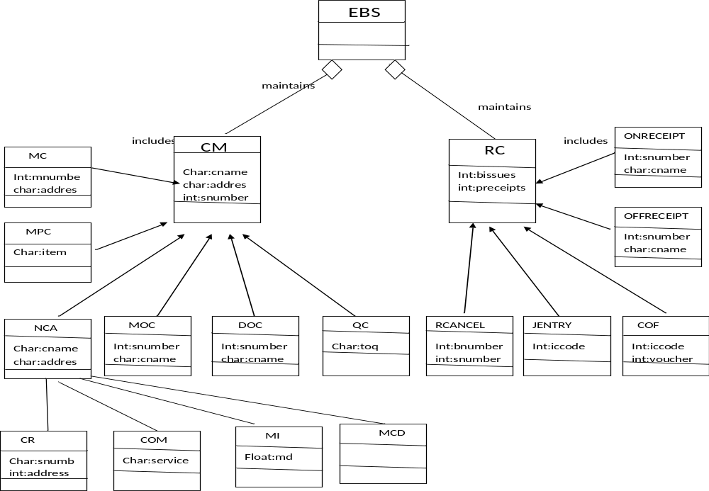
DIAGRAM

